Slide 1

A STUDY EXPERIMENTING WITH CNN ENSEMBLE, DEEPMIND PERCEIVER AND GENETIC ALGORITHMS ON COVID DETECTION USING CHEST X-RAYS
By
Srinivasaraghavan Seshadhri R00195470
MSc Artificial Intelligence
2020-2021

Slide 2
Agenda
Introduction
Goals
Existing research
Differences
Methodology
Results & Conclusion

Slide 3
Introduction
COVID19 is continuing to increasing in many parts of the world
Early diagnosis of the disease is crucial to save the patients
X-ray is faster, cost effective and non-invasive method
Number of Chest X-rays is very high
AI assistive diagnosis could be very helpful in such high volumes since they don’t get tired unlike humans and analyse data with very high number of data points
This research is to experiment with different deep learning techniques on the same

Slide 4
Goals
The main goal of this research is to try out new techniques in deep learning to identify covid from chest x rays and evaluate them.
To assess the performance of CNNs without any image pre-processing techniques except rescaling them down to 128x128 to save computation
To evaluate the difference of using genetic algorithms to optimize the weights of a network against gradient based methods
To try out the Neuro-Evolution of Augmenting Topologies (NEAT) algorithm to find a more efficient and optimized network architecture
To implement the new Deepmind perceiver architecture

Slide 5
Existing Research
A variety of NN and CNN based algorithms with different optimizers, image pre-processing (data balancing, histogram equalization etc) and image augmentation techniques
Different datasets used from a few hundred images to a few thousands (based on availability of data at the time of their research)
Very sparse research using Ensembles and Genetic algorithms
No research using Perceiver

Slide 6
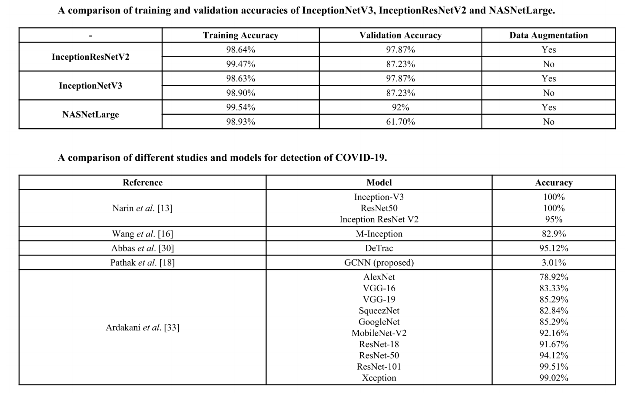
1102 balanced chest X-ray images in total were consolidated by combining three public datasets [9]

Slide 7
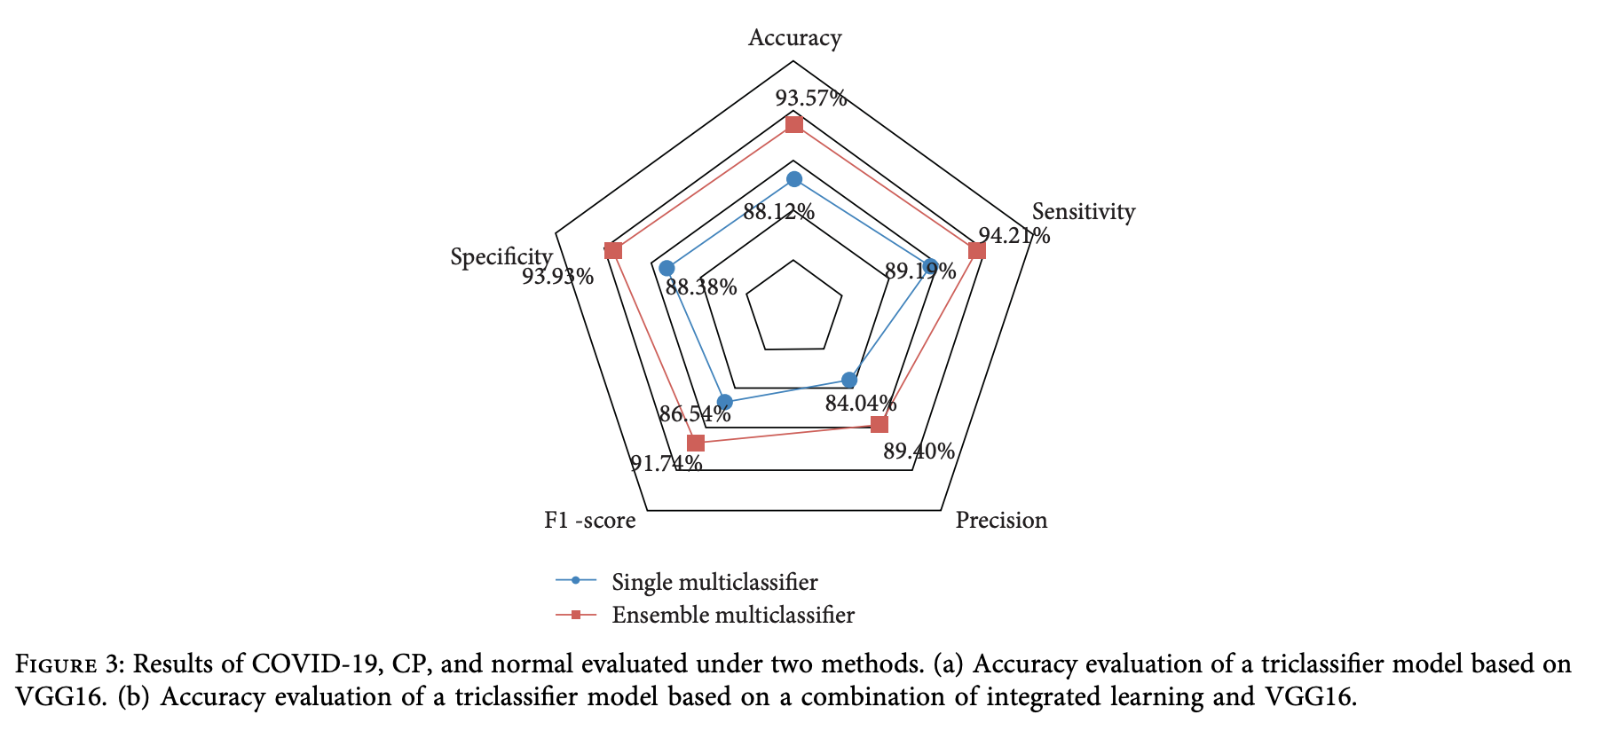
Ensemble Learning
Multiple state-of-the-art CNN models—DenseNet201, Resnet50V2 and Inceptionv3, have been adopted in the proposed work. They have been trained individually to make independent predictions. Then the models are combined, using a new method of weighted average ensembling technique, to predict a class value. To test the efficacy of the solution we have used publicly available chest X-ray images of COVID +ve and –ve cases. 538 images of COVID +ve patients and 468 images of COVID –ve patients have been divided into training, test and validation sets. The proposed approach gave a classification accuracy of 91.62% which is higher than the state-of-the-art CNN models as well the compared benchmark algorithm.
Das, A.K., Ghosh, S., Thunder, S. et al. Automatic COVID-19 detection from X-ray images using ensemble learning with convolutional neural network. Pattern Anal Applic 24, 1111–1124 (2021). https://doi.org/10.1007/s10044-021-00970-4

Slide 8
Genetic Algorithm
In this paper, a CNN model is used to build COVID-19 identification model using the chest X-ray images. 20-fold cross-validation is used to overcome the overfitting problem. A pretrained GoogLeNet is also considered for implementing the transfer learning (i.e., by replacing some sets of final network CNN layers). Finally, the multiobjective genetic algorithm is used for hyperparameter tuning of the COVID-19 identification model. Performance analysis revealed that the COVID-19 identification model attains significantly good performance than the competitive models. )ie proposed COVID-19 identification model offered training and testing accuracy up to 98.3827% and 94.9383%, respectively.
The proposed COVID-19 identification model offered training and testing accuracy up to 98.3827% and 94.9383, respectively.
Prashant Kumar Shukla, Jasminder Kaur Sandhu, Anamika Ahirwar, Deepika Ghai, Priti Maheshwary, Piyush Kumar Shukla, "Multiobjective Genetic Algorithm and Convolutional Neural Network Based COVID-19 Identification in Chest X-Ray Images", Mathematical Problems in Engineering, vol. 2021, Article ID 7804540, 9 pages, 2021. https://doi.org/10.1155/2021/7804540

Slide 9
Differences
CNNs:
Image size
No pre-processing
Ensemble:
Different base learners
Using direct SoftMax average
Using complex NN as ensemble
Genetic Algorithm:
Optimize all the weights of the network instead of the final layers
NEAT
Perceiver

Slide 10
Methodology
Image pre-processing: There were 10192 normal chest x ray and 3616 covid chest x ray images which were read, converted from 299x299 into a 128x128 3 channel array
Baseline CNN:
The networks Xception, VGG16, VGG19, ResNet50, ResNet101, ResNet152, ResNet50V2, ResNet101V2, InceptionV3, InceptionResNetV2, MobileNet, MobileNetV2, DenseNet121, DenseNet169, DenseNet201, NASNetMobile, NASNetLarge were trained
Ensemble networks selection:
Top 5 distinct networks which performed well were selected for ensembling techniques
Mean Ensemble:
The 5 selected trained models were made to predict individually and their sigmoid outputs were averaged as an ensemble
ELM Ensemble:
Following the previous experiment, based on individual learner predictions, their outputs were given as inputs to a single hidden layer neural network with 32 neurons and trained as an ensemble.
Deeper ANN:
Ensemble Based on individual learner predictions, their outputs were given as inputs to a deeper neural network and trained as an ensemble

Slide 11
Genetic Algorithm:
KerasGA library was used to optimize the weights of a network
NEAT algorithm:
A network topology was tried to be created and weights were tried to be optimized by a NEAT algorithm using PyTorch-NEAT library

Slide 12
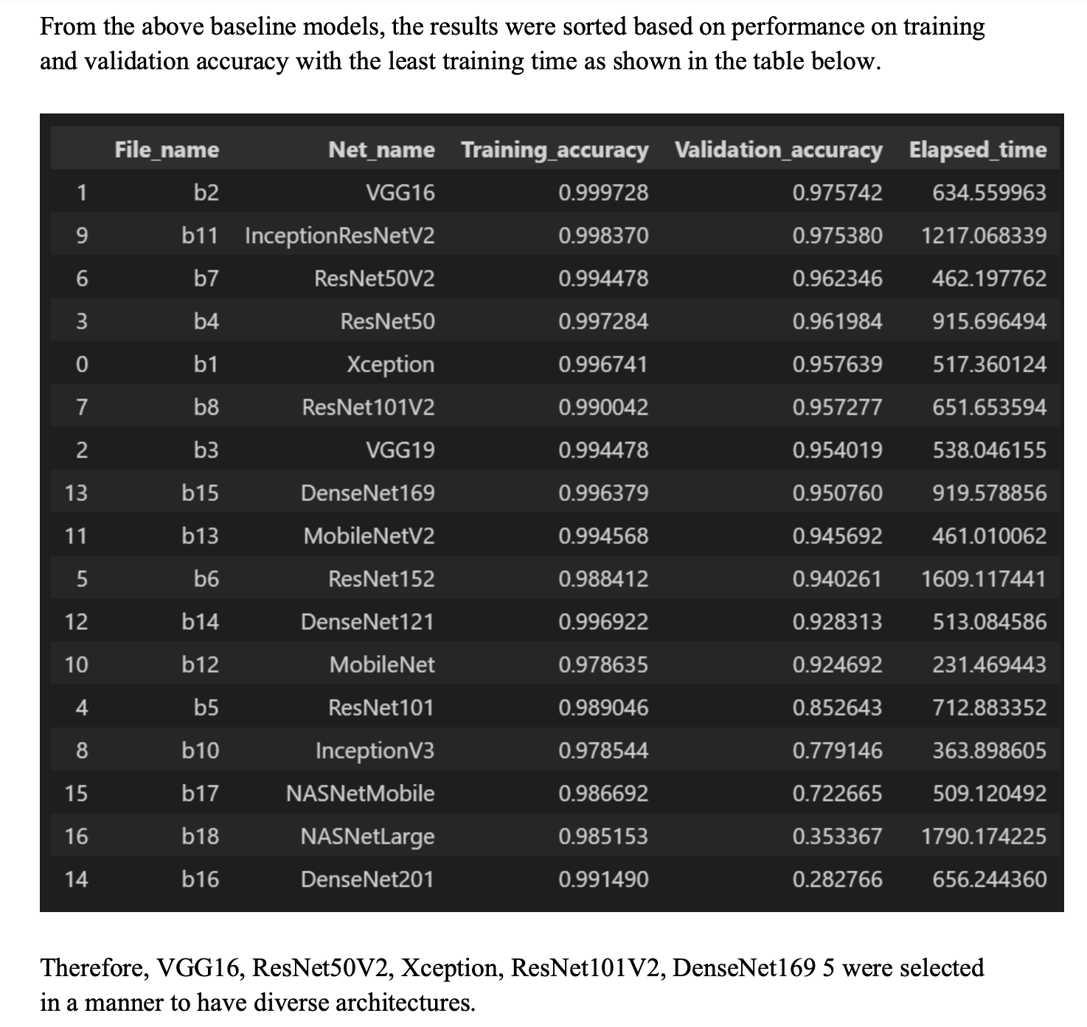
Results and Conclusions
CNNs:

Slide 13
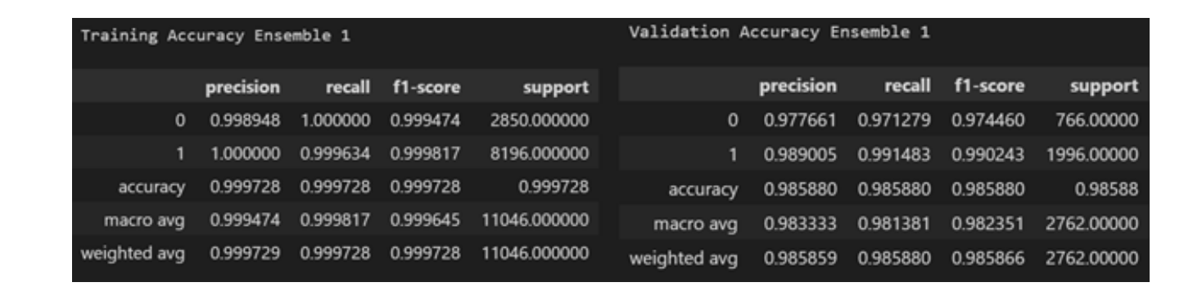
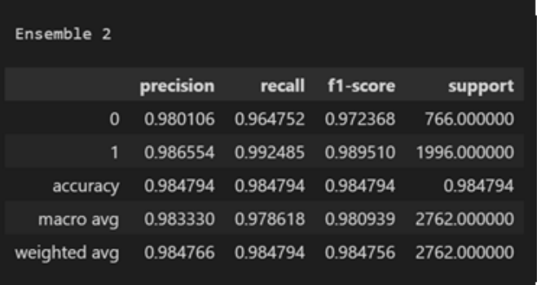
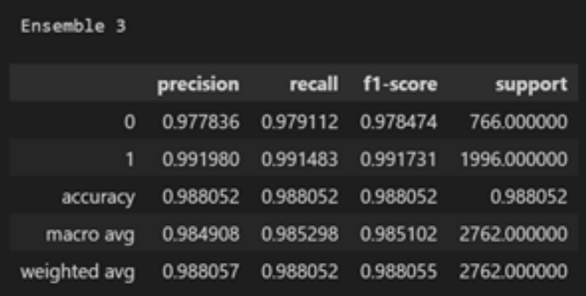
Mean Ensemble:
ELM Ensemble:
Deeper ANN Ensemble:

Slide 14
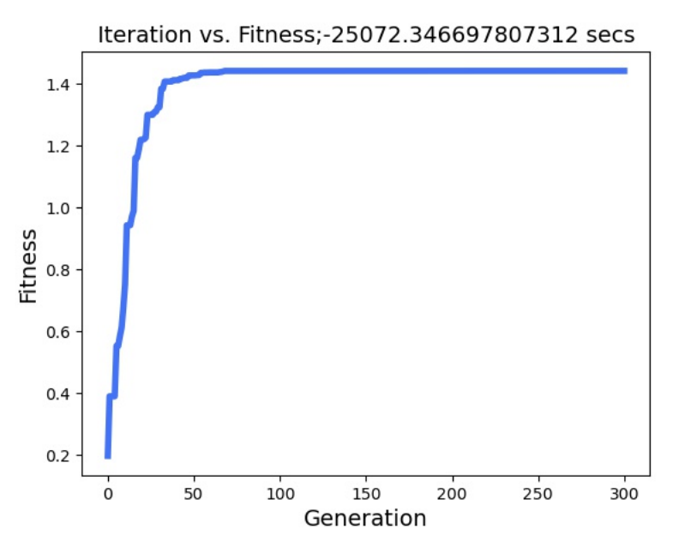
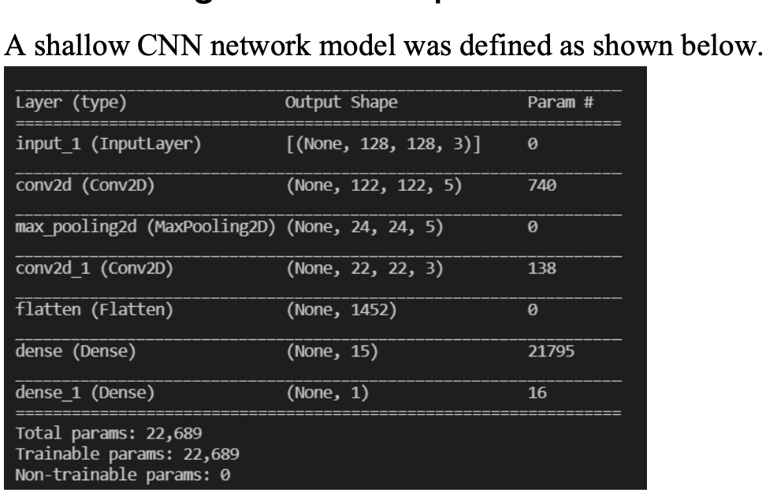
Genetic Algorithm:
NEAT:
The algorithm was applied on 128x128 images. This time, the fitness was binary cross entropy and was to be minimized. Even after several hours, not even the first generation was completed. Therefore, in order to check if the code was correct and if the network worked, the images were down sampled to 10x10 and the code was rerun. Unsurprisingly the code worked and the algorithm tried to optimize it, but since there were too little features that were non correlated, there was nothing for the network to learn and hence the fitness was oscillating,

Slide 15
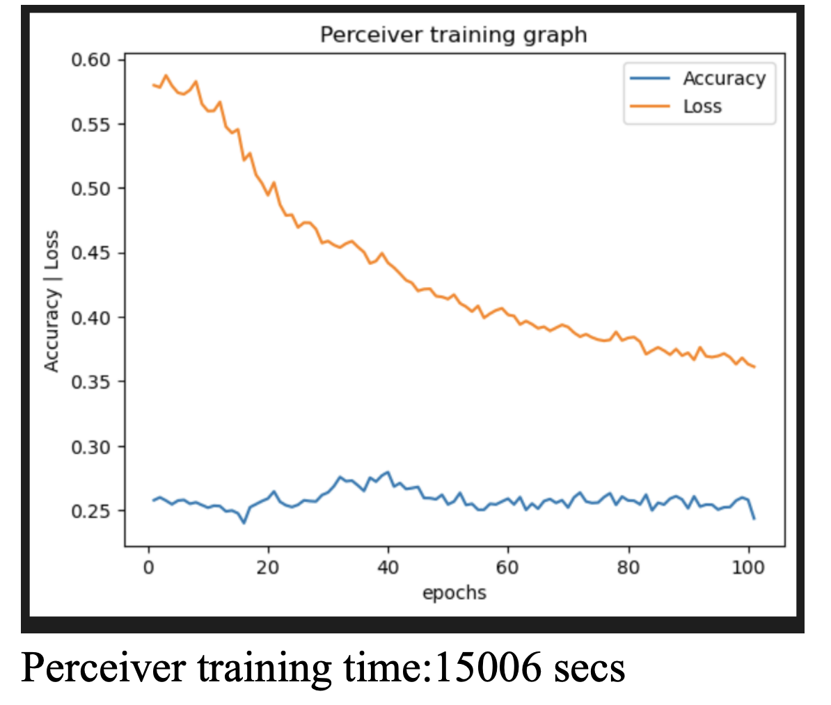
Perceiver:

Slide 16
Areas to Improve
Papers on Ensemble learning, genetic algorithm
Papers on ViT used for this application
Tables and figure identification and contents
Formatting

Slide 17
Future Work
To train the Perceiver, optimize it, evaluate and compare the performances against existing research in this application
To understand and reason the strengths and weaknesses of each CNN in this application
Fine tune CNNs and ensemble them
Based on the above, analyse and interpret the trained ensemble network with its weights on each input
To check if this network identifies pneumonia Xray as covid xray and analyse its performance with other variations
Computational power comparison in-between best networks
Applying Federated Learning Technique

